Slide 1

COM106: Introduction to Databases
Database Management – Storage Structures

Slide 2
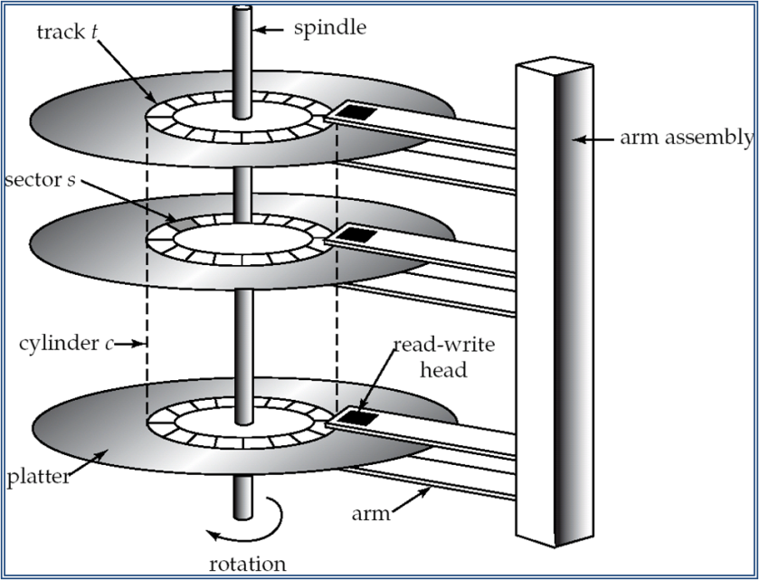
Database Management – Storage Structures
Overview
Physical Database Design
Key issues are efficiency and performance
How to store records efficiently on disk
How to retrieve records as quickly as possible
Background Issues
Disk Access, Physical Sequence, Virtual Sequence
Available Storage Mechanisms
ISAM, B-Trees, Hashing
Disk Access Review
Physical database design is the process of selecting the appropriate storage representation for database tables.
requires details and frequency of common accesses
Basic Storage Concepts (Hard Disk)
disk access time = seek time + rotational delay
disk access times are much slower than access to main memory
the overriding DBMS performance objective is to minimise the number of disk accesses (disk I/Os).
Disk access is the slowest component in queries on large tables

Slide 3
Storage Structures - DBMS/Hard Disk Interaction
File Manager: operating system or DBMS component
regards the disk as a collection of stored physical records (pages) each containing a number of stored logical records)
performs operations such as retrieve, add or remove a record from a stored file or create/destroy a stored file
Disk Manager: a component of the operating system responsible for all physical I/O operations
deals with physical disk addresses
performs tasks such as retrieving, adding or removing pages of data
DBMS
Request Stored Record
Stored Record Returned
File Manager
Request Stored Page
Stored Page Returned
Disk Manager
Disk I/O Operation
Data Read from Disk
Stored DB
A page (or block) – made up of a number of records - is the smallest unit of disk access
Physical vs Logical Records
Physical Record
Unit of transfer between disk and primary storage
Generally contains more than one logical record
Based on a page or block, which is a storage unit containing several database records
Generally one disk access involves several pages and hence a number of records
Logical Record
A database record consisting of a set of field (attribute) values

Slide 4
Storage Structures
Stored files may have more than one method of access:
Primary organisation: based on the physical location of individual records
Secondary organisation: independent of physical storage
File relationships implemented as access paths
As pointers between records
As physical record clustering (records from both files stored closely on the same or adjacent pages)
File organisation options include sequential, indexing, hashing and pointer chains
The storage structure is the arrangement of data on the hard disk
Many different storage structures are possible (e.g. ISAM, hashing, B-trees)
Different storage structures have different performance characteristics
No single structure is best for all applications (depends on table size, access frequency and type, update frequency, etc.)

Slide 5
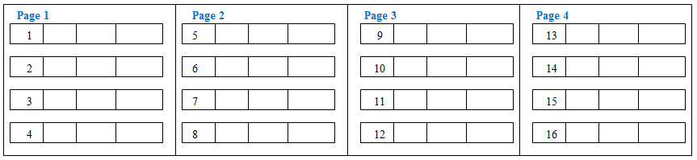
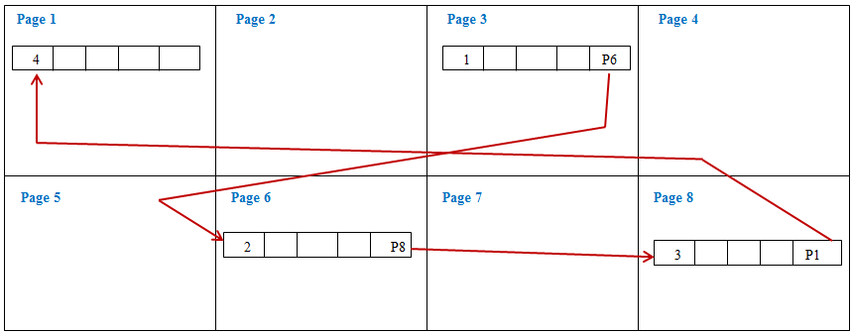
Sequential Organisation
In a sequentially organised file, records are placed in sequence (e.g. ascending order of primary key values)
useful for processing of most records in a table at one go (e.g. update of payroll system main file)
There are two types of sequential organisation:-
Physical sequence:
records are physically stored in sequence
insertion of records requires sorting entire file
Logical sequence:
stored records are logically linked in sequence by pointers (e.g. in network/ hierarchical databases)
insertion or deletion requires pointer redirection
EMP (enum, ename, salary, dnum) stored in enum order
EMP records stored in sequence in consecutive memory pages (physical sequence)
EMP (enum, ename, salary, dnum) stored in logical order
EMP records not stored in physical sequence but in logical sequence using a memory address (page pointer) to point to the page holding the next record in sequence (virtual sequence)

Slide 6
Database Storage Structures – File Organisation
File Organisation – The physical arrangement of data in a file into records and pages on secondary storage.
The main types of file organisation are:
Heap (unordered files) - Records are placed on disk in no particular order.
Sequential (ordered) files – Records are ordered by the value of a specified field
We shall look at ISAM (Indexed Sequential Access Method) and B-Tree
Hash files – Records are placed on disk according to a hash function
The Heap
The basic default storage structure in SQL Server if no clustered index is used
Records stored in order they arrive (no sorting)
Advantages
Quick loading of bulk records
Good for small tables
Disadvantages
Retrieval requires all records to be examined – sequential (or linear) search
Poor for tables with significant record changes (higher volatility)
So, for tables with a sizeable number of records (100s+) or higher volatility (higher rates of insert, update, delete) a different storage structure is necessary

Slide 7
Retrieving a Record from an Ordered File
In an ordered file, records are stored in order. A Binary Search can then be used to find the required record.
Consider the process of finding ‘record 37’ in a list of ordered records
Similar to manually finding a persons name in a telephone directory
Go to the middle record in the file.
If the required record is greater - go to the middle record in the top half of the file
Otherwise - go to the middle record in the bottom half of the file
Continue this ‘divide and conquer’ method, continually halving the number of records to be searched, until the required value is found.
Compare this binary search with a sequential search
On average, a sequential search of n records will take n/2 accesses.
For a small number of records, sequential search may be faster (less overhead).
For files with over about 100 records, binary search can be significantly more efficient.

Slide 8
Indexing
An index is a data structure allowing a DBMS to locate particular records more quickly and hence speed up queries
For example, a book index has each index term (stored in alphabetic order) with a page number
Likewise, a database index (on a particular attribute) has each attribute value (stored in order) with a memory address
An index gives direct access to a record and prevents having to scan every record sequentially to find the one required
However the index itself has to be searched to find the index entry required
An index can be clustered or nonclustered
Clustered index: created on attribute that is also physically sorted in attribute order (e.g. primary key)
Nonclustered index: created on attribute that is NOT sorted in attribute order
So a table can have one clustered index, but many nonclustered indexes
An index is composed of an ordered attribute list with a memory address (shown diagrammatically as a pointer) and allows direct access to a particular record.
Consider a relation SUPPLIER (s_num, sname, s_city)
Supplier table sorted in s_num value order
Index s_num
s_num | s_name | s_city
S1 | Smith | London
S2 | Jones | Paris
S3 | Brown | Paris
S4 | Clark | London
S5 | Ellis | Dublin
S1
S2
S3
S4
S5

Slide 9
Indexing
Using SUPPLIER (s_num, sname, s_city)
Consider the query ‘Get all the suppliers in a certain city ( e.g. London)’
Two possible strategies:
Search the entire supplier file for records with city 'London'
Create an index on cities, access it for 'London’ entries and follow the pointer to the corresponding records
Index s_city
s_num | s_name | s_city
S1 | Smith | London
S2 | Jones | Paris
S3 | Brown | Paris
S4 | Clark | London
S5 | Ellis | Dublin
Dublin
London
London
Paris
Paris
Indexes are primary (on primary key) or secondary (on another attribute)
Advantage: speeds up retrieval (at expense of update)
Index Use:
Sequential Access (using sequence of index records)
useful for range queries (Get suppliers whose cities begin with L-R)
Direct Access (using single value of index record)
useful for list queries (Get suppliers whose city is London)
Existence tests (using index access alone)
Eg. Are there any suppliers in Dublin? YES - if an entry for Dublin exists in the s_city index

Slide 10
Indexing
Multiple Indexes: a file can have any number of indexes (e.g. on s_num and on s_city)
a file with an index on every field is fully inverted
Indexes on combined attributes: indexes can be constructed on two or more combined attributes (e.g. s_name and s_city)
Dense vs. Nondense Indexes: s_city index is a dense index (all pointers are record pointers - they point to individual specific records), so same number of index records as actual records
Nondense indexes use page pointers instead of record pointers and do not contain an index entry for every record, so less index records than actual records
Append/Insert: when a new record is added to a table a new entry must be made in the index at the correct position and the record memory address added (for each index on that table)
Delete: when an existing record is deleted the corresponding index record with memory address must also be deleted (for each index on that table)
Update/Edit: if the attribute on which the table is indexed is changed, the index entry may have to be moved to the correct position in that index.

Slide 11
Indexing
Example of nondense (sparse) index on s_num
Retrieved pages are searched to find required records (unlike dense indexes)
Advantage: occupies less space than dense index and quicker to scan
Disadvantage: existence tests cannot be performed on the index alone
A stored file can have at most one nondense index (depends on the unique physical sequence of the file). All other indexes must be dense.
S1 | Smith | London
S2 | Jones | Paris
S3 | Brown | Paris
S4 | Clark | London
S5 | Ellis | Dublin
Page 1
S2
S4
S5
Page 2
Page 3

Slide 12
Indexed Sequential Access Method (ISAM)
Records are physically stored in sorted in order
allows quick sequential processing of all records (e.g. for payroll processing)
A (dense) index is built (normally on primary key)
allows direct access via the index
direct access not as efficient as for hashing
Usage
good for key fields
good for files requiring sequential processing
Microsoft ACCESS uses ISAM as its main storage mechanism
MyISAM storage engine is available in MySQL (instead of innobD or Memory)
Index overflow occurs because the space allocated for the index may be exceeded
An improved approach which prevents index overflow is known as VSAM (Virtual Sequential Access Method)

Slide 13
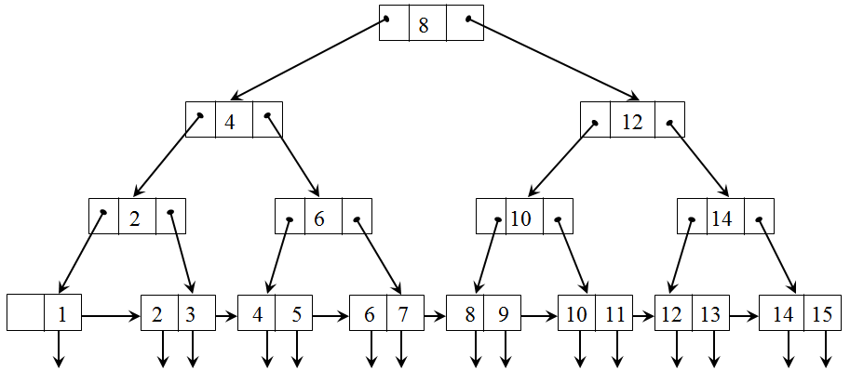
B-Trees
B-Trees are the best all round way to organise indexes (supported by large DBMSs)
Effectively, the index is indexed (using a multi-level, non-dense index )
A binary (or n-ary) access to the records is implemented
Principle:
indexing removes need for scanning entire file but for large files scanning the large index is a problem
Index can be treated as a file and indexed. This is continued with each level being a non-dense index to the level below
Index set: a tree-structure index to the sequence set
provides fast direct access to the sequence set and hence to the records
Index set
potential problem of B-trees is that due to insertion/deletion the tree may become unbalanced which requires algorithm designed to 'balance’ the tree
Sequence set
Sequence set: a single level dense index to the data
provides fast sequential access to the indexed data

Slide 14
B-Trees – Terminology and Rules
A Tree consists of a series of nodes, each (except the root) having one parent node and a number of child nodes
A root having no children is called a leaf node
Depth of a tree is the maximum number of nodes between the root and a leaf
If the depth is uniform across all paths the tree is balanced
The degree or order of a tree is the maximum number of children allowed per parent (2 in this case)
Access time is proportional to the tree depth, so shallow bushy trees are best
If the root is not a leaf node, it must have at least two children
For a tree of order n,
each node (except root or leaf nodes) must have between n/2 and n pointers and children. (If n/2 is not an integer, the result is rounded up)
the number of key values in the leaf node must be between (n-1)/2 and (n-1). (If (n-1)/2 is not an integer, the result is rounded up)
The number of key values contained in a non-leaf node is 1 less than the number of pointers
The tree must always be balanced; that is, every path from the root node to a leaf node must have the same length
Leaf nodes are linked in order of key values

Slide 15
B-Trees – Issues
B-Trees require complex maintenance since they must remain balanced to be efficient
Insertion and Deletion may unbalance the tree (change the depth along some pathways) and hence rebalancing must be performed - expensive
The overhead of performing this is traded off against the efficiency of access
B-Trees work best for large dynamic (high update rate) tables
Although indexes are intended to enhance a database's performance, there are times when they should be avoided:
Indexes should not be used on small tables.
Tables that have frequent, large batch delete or insert operations.
Indexes should not be used on columns that contain a high number of NULL values.
Columns that are frequently manipulated should not be indexed.

Slide 16
Hashing
Hashing provides fast direct access to a specific stored record on the basis of attribute value
Each record stored at page location whose address is computed as some function of record attribute value – Hash Function
Record is retrieved by recalculating page location and retrieving the record from the computed position
Records in a hash file will appear to be randomly distributed across the available file space – also called random or direct files
Various hashing techniques are used, but the hash function is chosen so that records are as evenly distributed as possible throughout the file
A Division-Remainder hash function is often used:
Chose the attribute to be used as the hash field
For each record, convert the field value to an integer and use the MOD function to generate the page address
ie, divide the hash field value by some predetermined integer and use the remainder as the page address.
e.g. if s_num is chosen as the hash field, and using a MOD 13 hash function.
Records with s_num 22, 31, 40, 49 and 58 are stored on pages 9, 5, 1, 10 and 6 respectively
Page 0
Page 1
Page 2
Page 3
Page 4
Page 5
Page 6
40
31
58
Page 7
Page 8
Page 9
Page 10
Page 11
Page 12
49
22

Slide 17
Hashing
A stored file can have many indexes, but only one hash structure
The records are not stored primary key sequence
Advantage: Allows quicker direct access than indexing
Speed of hashing = hash function time + 1 disk I/O (record retrieval)
Speed of indexing = index access time (greater) + 1 disk I/O (record retrieval)
Problems: Hash functions do not guarantee a unique address
When the same address is generated for a record as a previous record, and that page is full, a collision has occurred
On collision the next free page could be used (Open Addressing)
- but this could seriously slow access (two or more disk accesses)
A simple solution is to have an overflow area (Unchained Overflow)
- this necessitates a maximum of two disk accesses to retrieve the record
More sophisticated approaches include adding a pointer to the page the record should have been stored in to indicate where the record is actually stored (Chained Overflow)
To store a table using hashing, enough memory must be allocated in contiguous page addresses to hold them
Tables with high update rates may grow and cause marked deterioration in retrieval performance (increased collision rates)
Thus, hashed tables may require periodic reorganisation (larger area of memory allocated and table completely rehashed)

Slide 18
Storage Options and Comparisons
Not all DBMSs provide all available storage options;
e.g., MS ACCESS: provides ISAM only
MySQL: provides ISAM (default table type), B-tree and Hash
In SQL indexes and storage structures are applied using:
CREATE INDEX indexname ON tablename (columnname) USING indextype (BTree|Hash)
HEAP:
Unordered - keeps records in order they are entered
Hashing:
Most efficient method for direct access to an individual record.
Not efficient for accessing a sequence of records.
Large amount of 'overflow’ (collisions) cause direct access efficiency reduction (requiring physical reorganisation of data on disk)
Indexing:(ISAM)
Efficient method for small files or non-dynamic files (low update) for sequential and direct access.
Can also suffer from 'overflow’ problems when allocated memory for is exceeded
B-Tree:
Good all round performer for sequential and direct access.
Best for large or dynamic files (large update rate) but 'overhead’ in B-Tree maintenance.
Because of tree balancing 'overflow’ is not a problem.

